Slide 1
Data Structures
Stacks
Dr. Wedad Hussein
Information Systems Department
wedad.hussein@cis.asu.edu.eg
Dr. Hanan Yousry
Computer Science Department
hanan.hindy@cis.asu.edu.eg

Slide 2
Course Contents
Revision on classes & Pointers.
Stacks
Queues
Array Lists
Linked Lists
Binary Search Trees
Hash Tables
STL
Graphs

Slide 3
Dynamic Arrays

Slide 4
Problems with Static Arrays
Exceeding maximum:
Choosing a real maximum is often impossible.
Declaring very large arrays can be extremely wasteful of memory.
No expansion.

Slide 5
Creating Dynamic Arrays
Create a pointer to the array:
int* arr = new int[5];
It points at the first element in the array.
Elements are stored in consecutive positions.
Use the delete operator:
delete[] arr;

Slide 6

Stacks

Slide 7
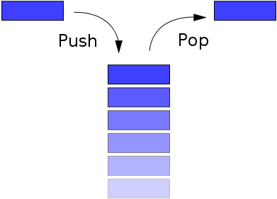
The Stack ADT
A stack is a list with the restriction that insertions and deletions can be performed in only one position, the end of the list (LIFO).

Slide 8
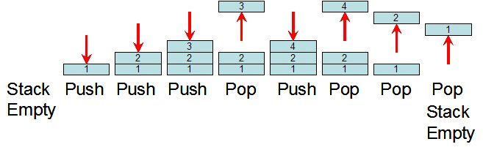
Push and Pop Operations

Slide 9
Stack Operations
Length: Returns the number of elements.
Push: adds an element to the top of the stack.
Pop: removes the top element.
Top: returns the top element.
Empty: returns whether the stack is empty.

Slide 10

Implementation

Slide 11
Abstract Data Types
An abstract data type (ADT) is a set of objects together with a set of operations.
An ADT is fully described by a domain of values together with a set of operations to manipulate these values.
E.g. set: a collection of distinct objects, Operations: add, remove, size, and contains.
There is no mention on how the set of operations are implemented.
ADT vs. Data Structure

Slide 12
Stack ADT Implementations
Using Linked Lists:
Top
9
8
7
Using Dynamic Arrays:
Top
 |  | 5 | 6 | 7 | 8 | 9

Slide 13
Stack Operations
Length: Returns the number of elements.
Push: adds an element to the top of the stack.
Pop: removes the top element.
Top: returns the top element.
Empty: returns whether the stack is empty.

Slide 14
Stack STL

Slide 15
STL
Standard Template Library.
It is a C++ library of container classes and algorithms.
It provides many of the basic algorithms and data structures of computer science.

Slide 16
Stack STL
stack<T>
Operations:
empty
pop
push
size
top

Slide 17
Applications

Slide 18
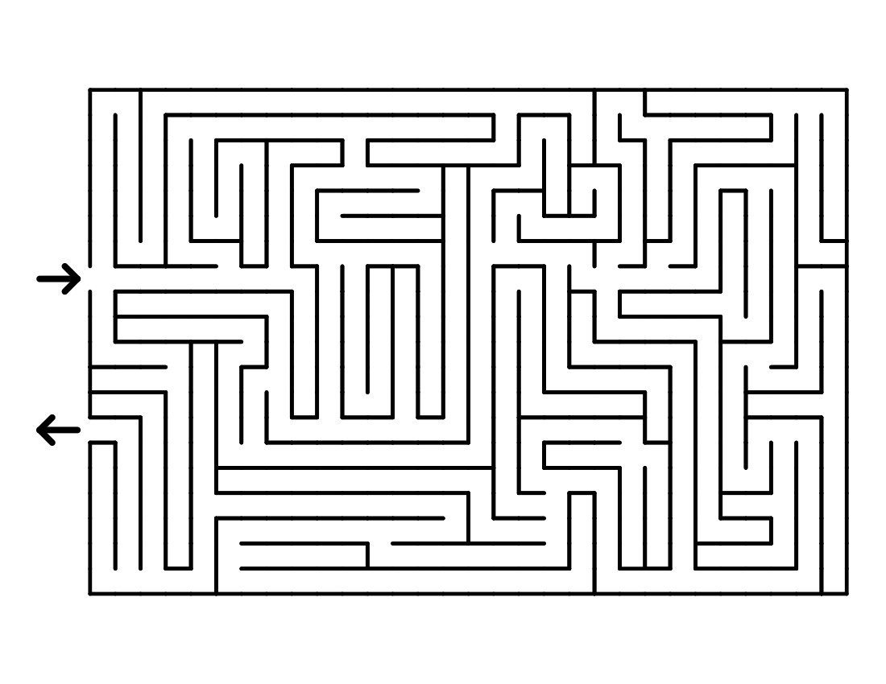

1. Undo operations and Backtracking

Slide 19
2. Balancing Symbols
Compilers should check whether everything is balanced.
Thus, every right brace, bracket, and parenthesis must correspond to its left counterpart.
Steps:
Read characters until end of file.
If the character is an opening symbol, push it onto the stack.
If it is a closing symbol and the stack is empty, report an error.
Otherwise, pop the stack.
If the symbol popped doesn’t match, report an error.
At end of file, if the stack is not empty, report an error.

Slide 20
3. Call Stack
On calling a function, it is important to save the address of next instruction that needs to be executed in the program.
For saving a return address, it needs to be put somewhere in the memory.
The conventional method is to push in to the stack.
Also, a function needs to save the parameters before executing its instructions, which will also be pushed in the stack.
This forms the call stack.
https://www.youtube.com/watch?v=Q2sFmqvpBe0

Slide 21
Infix, Prefix and Postfix Expressions
Infix | Prefix | Postfix
A+B | +AB | AB+
A+B*C | +A*BC | ABC*+
(A+B)*C | *+ABC | AB+C*

Slide 22
4. Evaluating Postfix Expressions
Infix Expression 6*(5+(2+3)*8+3)
Equivalent to Postfix: 6 5 2 3 + 8 * + 3 + *
Easier to be evaluated.
Could be evaluated using a stack.
Also called “Reverse Polish Notation”.
Steps:
Operands are pushed into the stack.
When an operator is encountered the last 2 operands are popped and replaced with the result.

Slide 23
4. Evaluating Postfix Expressions cont.
6 5 2 3 + 8 * + 3 + *
3
2
5
6

Slide 24
4. Evaluating Postfix Expressions cont.
6 5 2 3 + 8 * + 3 + *
3
2
5
6
5
5
6

Slide 25
4. Evaluating Postfix Expressions cont.
6 5 2 3 + 8 * + 3 + *
8
5
5
6

Slide 26
4. Evaluating Postfix Expressions cont.
6 5 2 3 + 8 * + 3 + *
8
5
5
6
40
5
6

Slide 27
4. Evaluating Postfix Expressions cont.
6 5 2 3 + 8 * + 3 + *
40
5
6
45
6

Slide 28
4. Evaluating Postfix Expressions cont.
6 5 2 3 + 8 * + 3 + *
3
45
6

Slide 29
4. Evaluating Postfix Expressions cont.
6 5 2 3 + 8 * + 3 + *
3
45
6
48
6

Slide 30
4. Evaluating Postfix Expressions cont.
6 5 2 3 + 8 * + 3 + *
48
6
288

Slide 31
5. Infix to Postfix Conversion
We can also use a stack to convert an expression in standard form into postfix.
E.g. a + b * c + ( d * e + f ) * g
Postfix:
a b c * + d e * f + g * +

Slide 32
5. Infix to Postfix Conversion
When an operand is read, output it
When an operator is read
Pop until the top of the stack has an element of lower precedence
Then push it
When ) is found, pop until we find the matching (.
( has the lowest precedence when in the stack but has the highest precedence when in the input.
When we reach the end of input, pop until the stack is empty

Slide 33
Competition (1 Point)
A player is playing a card game where he draws cards from a pile. He can draw one card each round and the card is placed on top of an initially empty pile. If the card he draws matches the card at the top of the pile, both cards are discarded. The player wins if he has three cards or less left in his pile. Write a C++ program that takes the number of cards the player draws and a sequence of letters representing each card. The output of the program should be whether the player won or lost. Use the appropriate data structure. The following are example test cases
Inputs |  | Output | Remaining cards
Sequence size | sequence
6 | ABCCBA | Yes | 0
8 | ABBACDDA | Yes | 2
7 | BCDDABC | No | 5

Slide 34
Try this at home
A player is playing a cards game where he draws cards from a pile. He can draw one card each round and the card is one of four options:
W: gives the player 5 points,
D: the double win card which gives the player 10 points,
C: cancels the wins of the last round,
S: the player wins the sum of the points in the last two valid rounds (that has not been cancelled).
Given a sequence of cards, write a C++ function to calculate the player's final points. Use the appropriate data structure. You can use STL containers.
The input is the number of rounds and a sequence of characters representing the cards.

Slide 35
Try this at home cont.
if the input is 5 and the following sequence of values: W D W C S, the output should be 30 , this is calculated as follows:
Round 1: W: the user wins 5 points, the total points become 5.
Round 2: D: the user wins 10 points, the total points become 15.
Round 3: W: the user wins 5 points, the total points become 20.
Round 4: C: cancels the wins of round 3 which was 5 points so the points become 15.
Round 5: S: wins the sum of the last two valid rounds which are round 1 and round 2 so we add 15 point to the wins and the final points are 30.

Slide 36
Lecture Resources
Lecture Notes.
Lecture Code.
Text Book:
Chapter 3: 3.6.

Slide 37
Thank You

